Slide 1
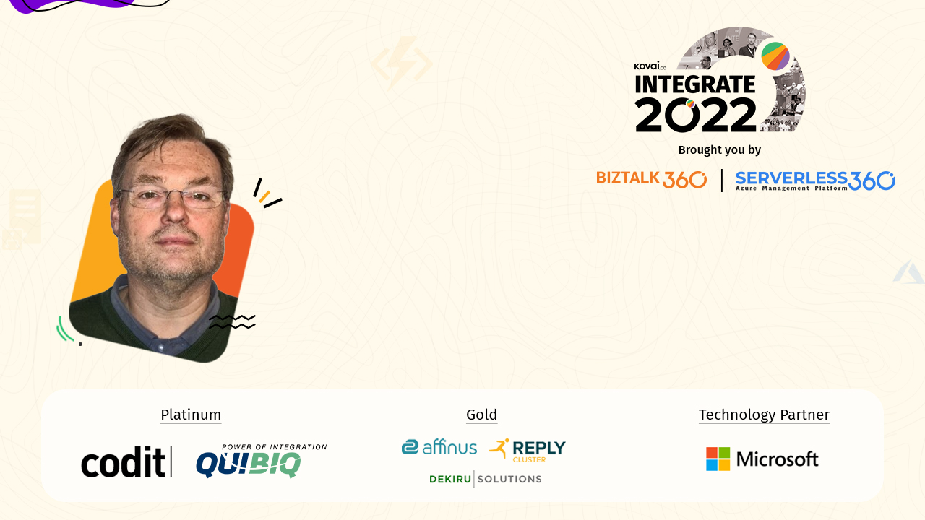
Samuel Kastberg
Principal Consultant – Solidify
Managing the lifecycle of your Logic Apps

Slide 2
Agenda
Separating deployment of artifacts
Built-in and Managed connectors
Structure of involved components
Working with connectors
Demo - Generate connections with Bicep
Demo - Connections in Visual Studio Code
Pipelines
Demo – Yaml pipelines

Slide 3
Separating deployment of artifacts

Slide 4
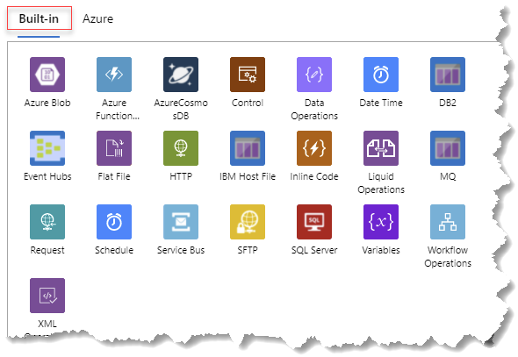
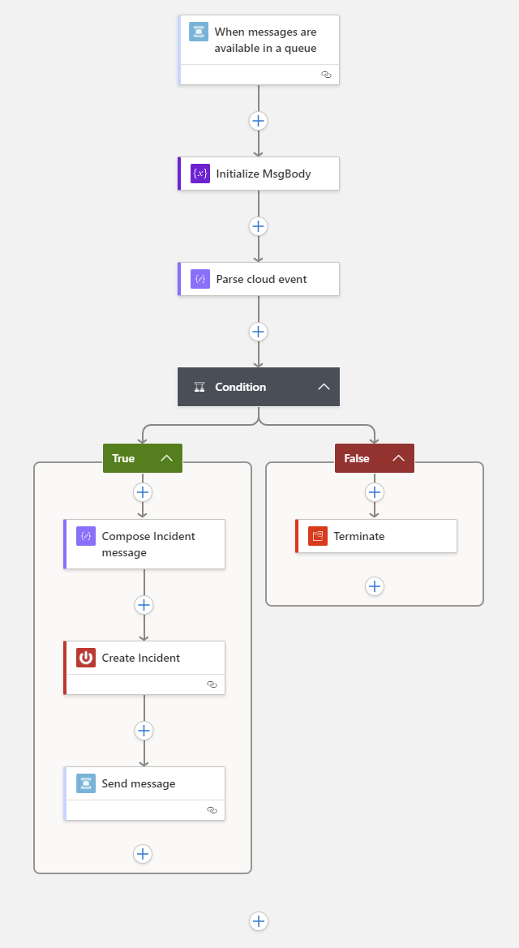
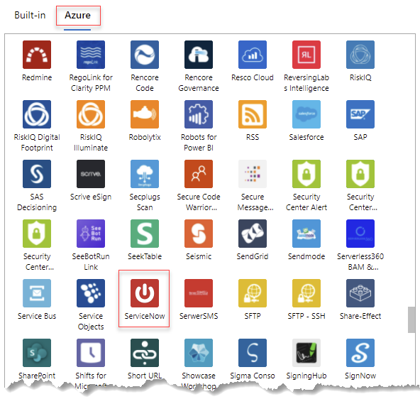
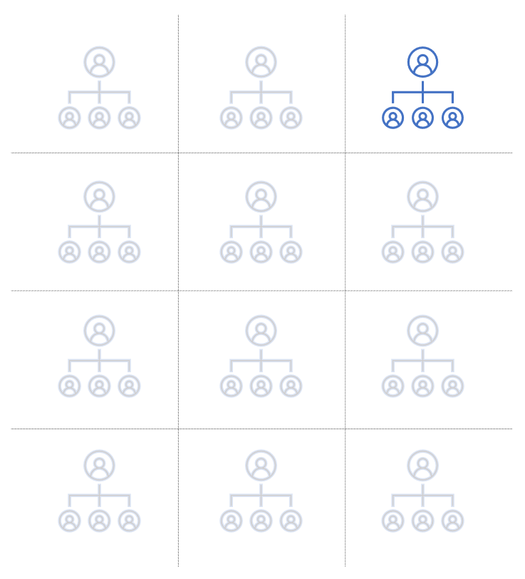
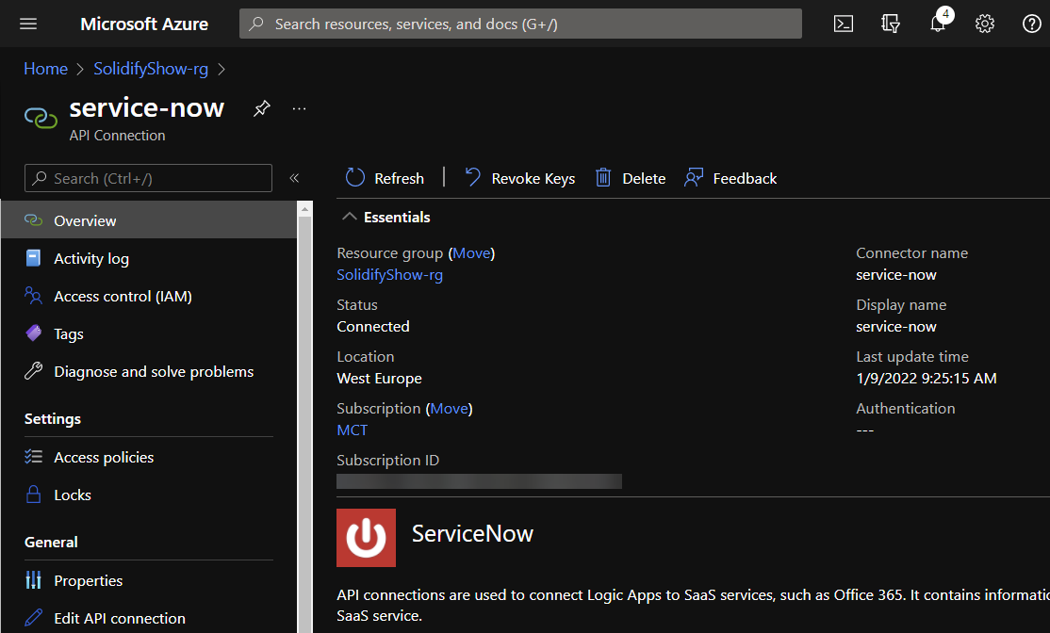
Built-in and Azure connectors
Standard (Single-tenant)
Consumption (Multi-tenant)
Built-in connections runs in process
Managed connectors, a call to “consumption”

Slide 5
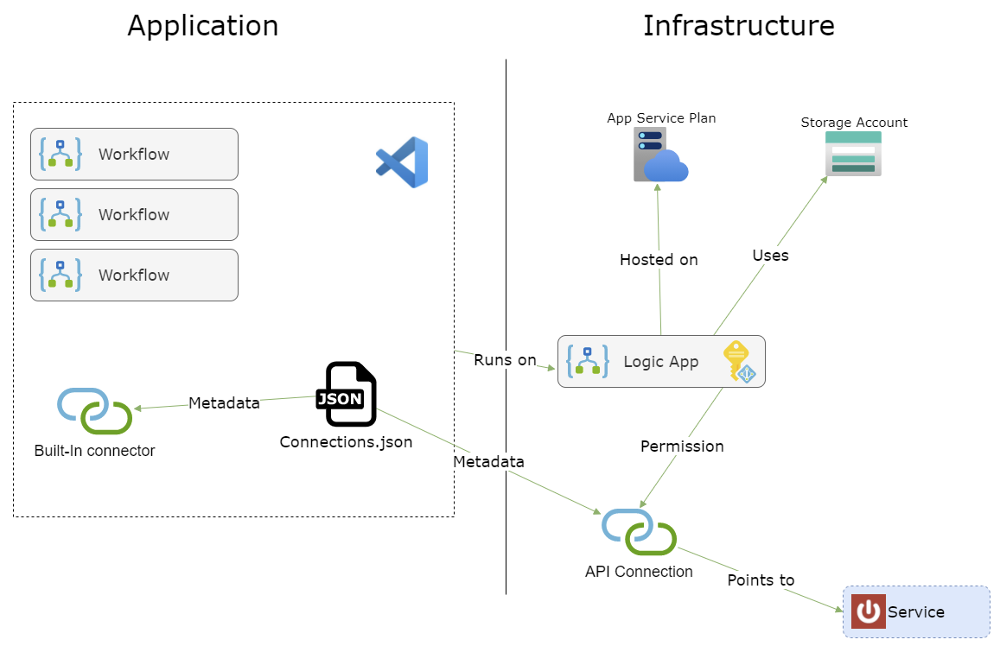
Structure of components

Slide 6
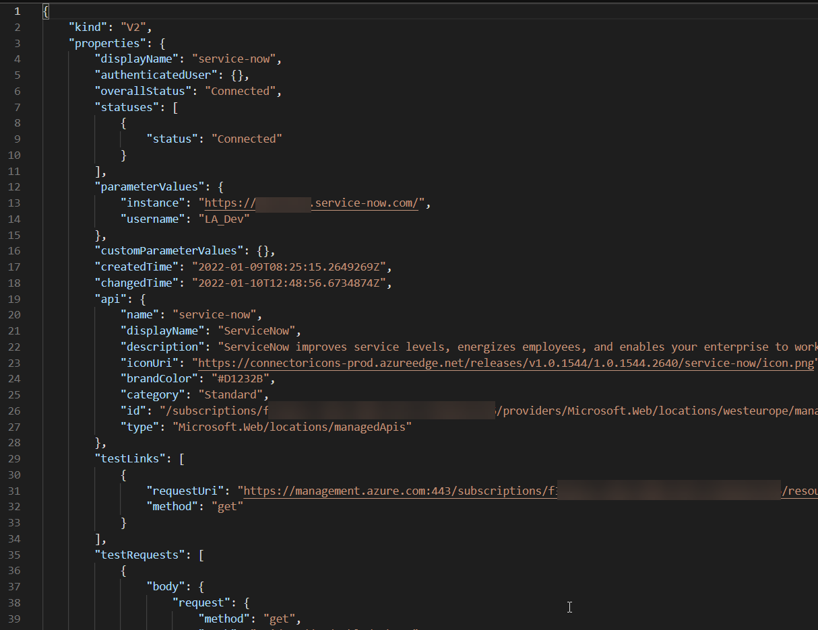
Creating Managed connections with Bicep
Microsoft.Web/connections
To get hints
Create a connection in the portal (Logic App … tooling please) review json
Call API GET https://management.azure.com/subscriptions/{subscription-ID}/providers/Microsoft.Web/locations/{location}/managedApis/{connector-name}?api-version=2016-06-01
All parameters should be in parameterValues
Create Bicep modules for your most common connectors
Script to generate in my GitHub repo https://github.com/skastberg/Integrate-2022

Slide 7
Demo
Generate connections with Bicep

Slide 8
Connections.json
Metadata for both Built-In and Azure Connections
Contains development data
Connection Keys expire after 7 days
403 error
Needs to be parameterized or generated at deployment
Valid expressions
@appsetting
@parameters
Create Azure connections directly with Bicep | ARM | Terraform
Solution to get updated connection keys in my GitHub Repo

Slide 9
Demo
Connections in Visual Studio Code

Slide 10
Other files that might differ between environments
Parameters.json
Common to all workflows in the Logic App
Only valid expression type is @appsetting
Host.json
Runtime settings like timeout values and other limits

Slide 11
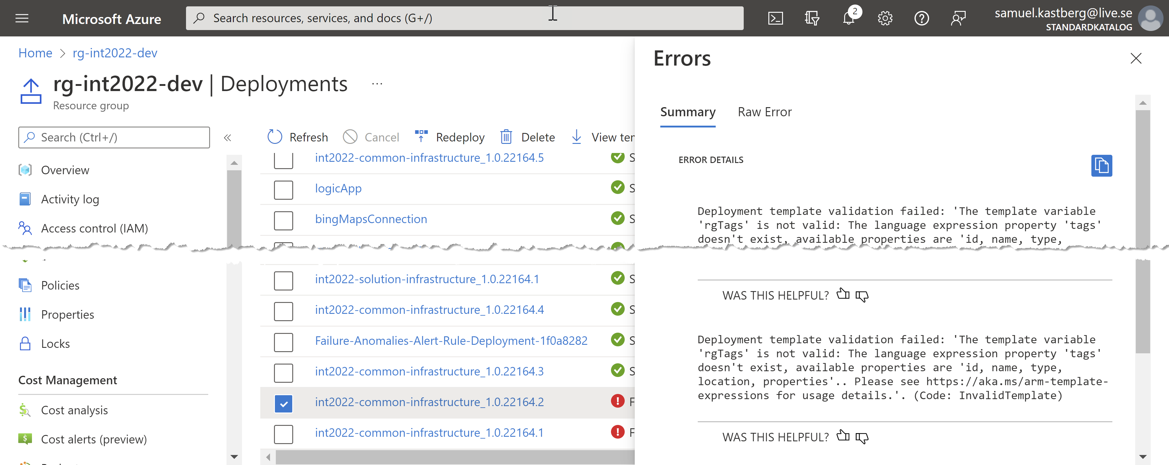
Pipelines
Infrastructure
Azure Resource Manager Template Deployment
Solution
Handle connections.json
Handle parameterization
Package files
Azure Function Apps deploy
Troubleshooting
Pipeline output
Resource group deployment

Slide 12
Demo
Yaml Pipelines

Slide 13

Thank you!
Resources:
GitHub Repository https://github.com/skastberg/Integrate-2022
Bicep at Microsoft Learn https://docs.microsoft.com/en-us/learn/browse/?terms=Bicep

